Slide 1

Experiment 1 Perceptron
Acknowledge to: Guoqiang Zhong
Organizers: Guoqiang Zhong, Zhaoyang Niu
Machine Learning Research Group
Ocean University of China
Qingdao, China

Slide 2
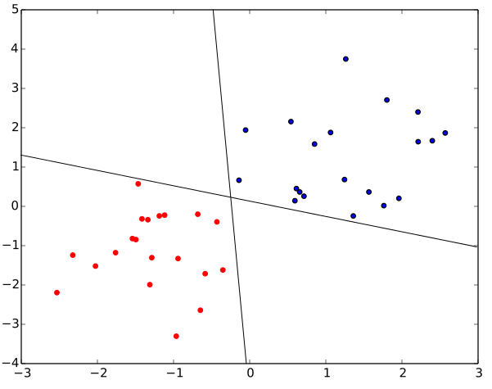
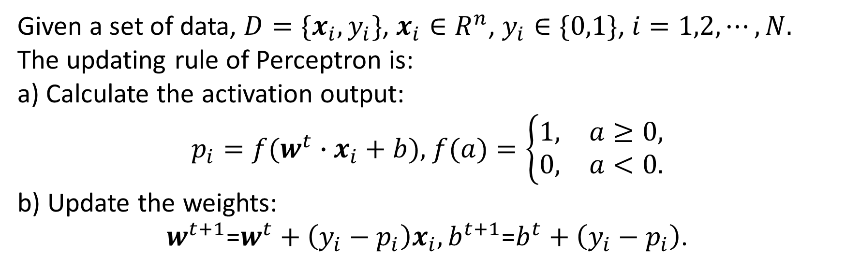
Perceptron
Given a set of data, ${D=\{x_{i},y}_{i}\}$, $x_{i}∈R^{n}$, $y_{i}∈\{0,1\}$, $i=1,2,⋯,N.$ The updating rule of Perceptron is:
a) Calculate the activation output:
$p_{i}=f(w^{t}∙x_{i}+b),$ $f(a)=\left\{\begin{matrix}1, & a≥0, \\ 0, & a<0.\end{matrix}\right.$
b) Update the weights:
$w^{t+1}$=$w^{t}+\left(y_{i}−p_{i}\right)x_{i},b^{t+1}\text{=}b^{t}+\left(y_{i}−p_{i}\right)$.

Slide 3

Experiment
Install Jupyter from https://jupyter.org/index.html.
Define a two-class problem, including 30 positive data and 30 negative data.
Write the code of perceptron using Python.
Submit your compressed code, result and report in one week to DL2021Spring@163.com. The code should be reproducible, the result includes classification accuracy, visualization and that for analysis, while the report introduces the detailed process of your experiments.

Slide 4
Thank you!

